Slide 1
SRI GURU KRUPA
Mission presentation · 2026
Preserving Dharma.
Serving devotees.
Inspiring generations.
Notes:
Open with SriGuruKrupa as a living seva mission, not merely a website.
[Sources]
- SriGuruKrupa project vision and About-page brief, reviewed 27 July 2026.

Slide 2
Why this mission matters now
A timeless tradition needs thoughtful modern access
Families seek trustworthy guidance, yet knowledge is scattered across languages, books, oral traditions and unverified digital content.
SriGuruKrupa connects authentic human guidance with clear, accessible technology.
Preserve
Make accessible
• Sources and sampradaya context
• Guru and scholar review
• Respect for living traditions
• Kannada, English and Telugu
• Families, elders and children
• Web, audio, video and learning
02
Notes:
Frame the challenge as access plus authenticity. Technology supports qualified guidance; it does not replace it.
[Sources]
- SriGuruKrupa content policy and project charter, reviewed 27 July 2026.

Slide 3
Our motto, mission, vision and values
Motto
Preserving Dharma • Serving devotees • Inspiring generations
Mission
Clear guidance, respectful coordination, reviewed knowledge and thoughtful technology.
Vision
A trusted multilingual Dharma ecosystem accessible across generations.
Values
Authenticity • Personal care • Clarity • Responsible technology
03
Notes:
Describe the four statements as decision filters for every service and publication.
[Sources]
- https://www.srigurukrupa.com/about.html

Slide 4
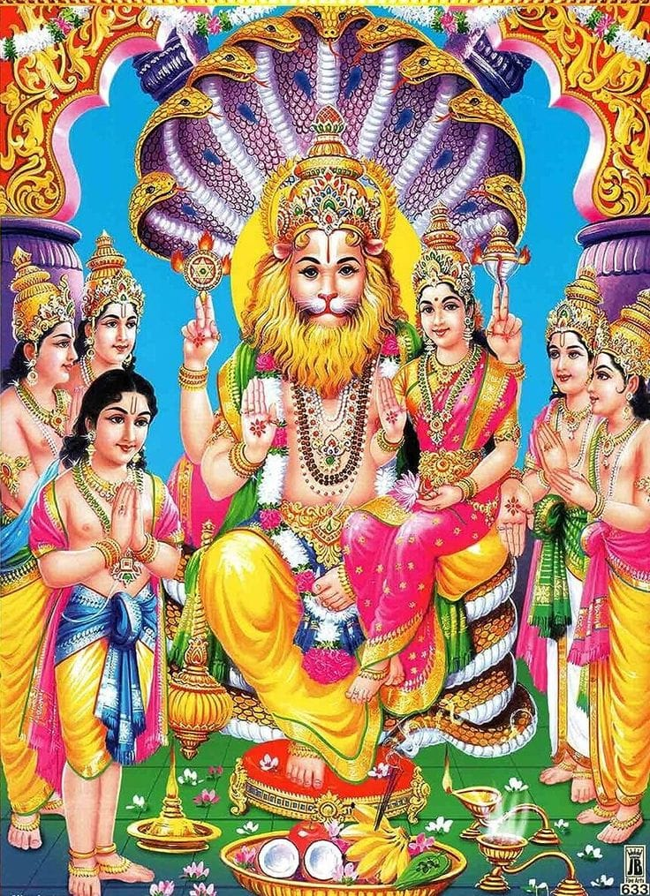
Sanatana Dharma
Dharma connects inner growth with everyday conduct.
It invites enquiry, self-discipline, devotion, service, compassion and responsibility toward family, society, nature and the divine.
SriGuruKrupa presents traditions with source context and respect for different sampradayas.
04
Notes:
Use the family deity image as a devotional anchor. Avoid presenting one philosophical interpretation as the only Sanatana view.
[Sources]
- Bhagavad Gita 3.19, 4.7–8 and 12.13–14.
- Image: Sri Lakshmi Narasimha Swamy, supplied by SriGuruKrupa.

Slide 5
The Vedas: heard wisdom, preserved through disciplined transmission
Four Vedas
Rig • Yajur • Sama • Atharva
A vast corpus of mantra, ritual, reflection and sacred knowledge.
Living practice
Accurate recitation, lineage, study and application require qualified teachers and patient learning.
Our role
Create respectful introductions, learning pathways and verified links—not replace a guru or Veda pathashala.
05
Notes:
Explain that the platform can make discovery easier while oral teaching and recitation discipline remain central.
[Sources]
- https://vedicheritage.gov.in/
- https://ich.unesco.org/en/RL/tradition-of-vedic-chanting-00062

Slide 6
Pooja and spirituality: meaning before transaction
Pooja can cultivate attention, gratitude, discipline and devotion
Ritual meaning, family sampradaya, sankalpa and qualified priestly guidance matter as much as logistics.
SriGuruKrupa’s service model begins by listening, clarifying scope and coordinating with one-to-one care.
Devotional care
Responsible coordination
• Pooja and Homa
• Shraddha and Pitru Karma
• Parayana and family guidance
• Clear inclusions and expectations
• Priest and material coordination
• Respectful follow-up
06
Notes:
Emphasize that ritual practice varies by family and sampradaya; detailed procedures require qualified guidance.
[Sources]
- SriGuruKrupa Pooja Services requirements, reviewed 27 July 2026.

Slide 7
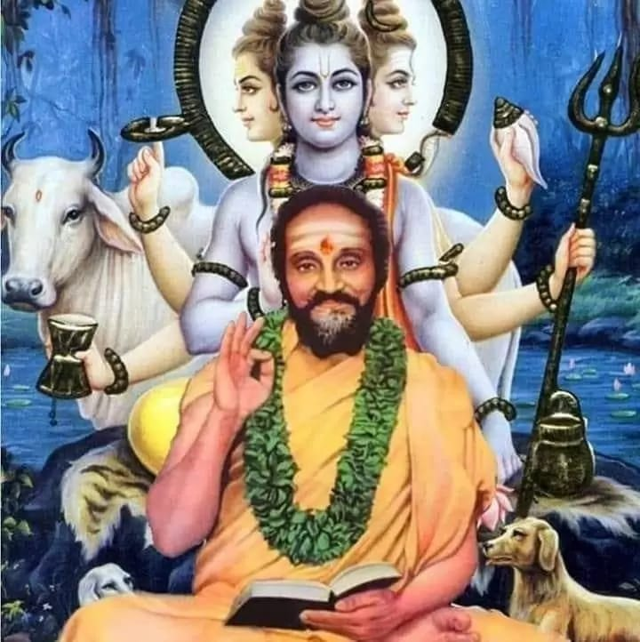
Dharma for children
The goal is not simply more digital content.
Short Ramayana, Mahabharata, Bhagavad Gita and value-based stories should invite a child to listen, repeat, draw, question, practise and discuss with family.
Age-appropriate scripts, subtitles and parent guidance will remain essential.
07
Notes:
Describe a child-safe, family-guided media model. The Guru image represents guidance and continuity across generations.
[Sources]
- SriGuruKrupa Children’s Dharma requirements, reviewed 27 July 2026.
- Image: Sri Sridhara Guru with Dattatreya, supplied by SriGuruKrupa.

Slide 8
One trusted ecosystem, built in responsible phases
Knowledge
Guru Parampara
Encyclopedia
Granthas
Reading guides
Source links
Pooja
Personal service
Clear process
Veda
Online and offline
Teacher-led
Yatra
Temple journeys
Local verification
Children
Stories
Activities
Media
Pravachana
Shorts
Community
Feedback
Volunteers
08
Notes:
Show breadth without promising that every module is complete. Development remains phased and reviewed.
[Sources]
- SriGuruKrupa website requirements register, reviewed 27 July 2026.

Slide 9
Temples of India: useful breadth with honest boundaries
140 sites
A curated major, historic and pilgrimage edition—not a census.
32 in Karnataka
Dharmasthala, Kukke, Nanjangud, Chamundeshwari and many more.
28 states
At least four reviewed discovery entries in every Indian state.
Fast by design
12-card progressive rendering, lazy images, search and state filters.
09
Notes:
State clearly that the directory is curated and evolving. Current travel, seva and accommodation details must be rechecked before payment.
[Sources]
- SriGuruKrupa Temples of India dataset, edition 27 July 2026.
- https://www.incredibleindia.gov.in/en/attractions

Slide 10
How people can contribute to SriGuruKrupa
Knowledge
Scholars and practitioners
Source review
Temple verification
Skills
Translation and proofreading
Children’s education
Technology and media
Reach & support
Community introductions
Rights-cleared photography
Defined voluntary sponsorship
10
Notes:
Ask for specific help rather than a generic request. Time, review and trusted introductions are as important as money.
[Sources]
- SriGuruKrupa Support the Mission page, edition 27 July 2026.

Slide 11
A humble financial request—with safeguards first
Support should follow a defined purpose, verified payment identity and clear records
SriGuruKrupa will activate PhonePe/UPI only after the founder’s exact UPI ID, account ownership, receipt process and contribution policy are verified.
Until then, no digital payment is requested and supporters are warned against unlisted handles.
Use of support
Trust principles
• Scholar and editorial review
• Three-language access
• Children’s learning and hosting
• Voluntary, never pressured
• Receipts and internal records
• Campaign progress updates
11
Notes:
Do not display or infer a UPI handle until it is supplied and verified by the founder. Do not promise tax deductions without formal eligibility.
[Sources]
- SriGuruKrupa contribution safeguards, edition 27 July 2026.

Slide 12
JOIN
Build a trustworthy
home for Dharma—together.
Share knowledge or volunteer
SriGuruKrupa.com
+91 94831 41592
Notes:
Close with a specific invitation: review, translate, volunteer, introduce or express support interest.
[Sources]
- SriGuruKrupa contact information, reviewed 27 July 2026.

